Slide 1
Customer Engagement & Product Utilization Analytics for Retention Strategy
Identifying churn risk and driving retention through data driven strategy.

Slide 2
1. Introduction
Customer retention is one of the most critical challenges faced by banks and financial institutions. Acquiring new customers is often more expensive than retaining existing ones. Therefore, understanding customer engagement patterns and product utilization behaviour is essential for reducing customer churn and improving long-term profitability.

Slide 3
2. Churn Challenge
Problem Statement:
Banks face significant losses when customers discontinue their services. Customer churn can occur due to low engagement, limited product usage, dissatisfaction, or lack of personalized services.
Goal:
To identify the factors influencing customer churn and recommend strategies that improve customer retention through engagement enhancement and product utilization optimization.

Slide 4
3.Objectives
(A) Primary Objectives
(B) Secondary Objectives
Evaluate engagement ↔ churn relationship
Measure product ownership impact on retention
Identify disengaged high-value customers
Analyze churn across customer segments
Improve product bundling
Reduce premium customer churn
Enhance customer lifetime value

Slide 5
4.Dataset Overview
European banking institution have 10,000 customers
Variable | Description
Customer Id | Unique customer identifier
Geography | Customer location
Gender | Customer gender
Age | Customer age
Tenure | Years with bank
Credit Score | Customer credit score
Balance | Account balance
Num Of Products | Number of products owned
Has Cr. Card | Credit card ownership
Is Active Member | Customer engagement status
Estimated Salary | Annual estimated salary
Exited | Churn indicator
Target Variable
Exited
1 = Customer Churned
0 = Customer Retained

Slide 6
5. Methodology
Data Validation
Customer Segmentation
Excel Analysis
SQL Analysis
Dashboard Development

Slide 7
6.Excel Analysis
.
Derived Fields
Engagement Status, Product Category, Balance Category, Customer Profile
Customer Profiles
Active Engaged · Inactive Disengaged · Active Low-Product · Inactive High-Balance

Slide 8
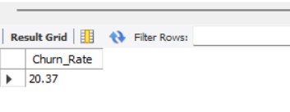
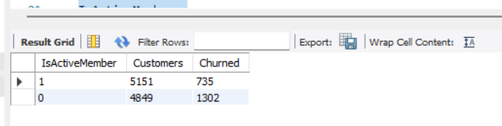
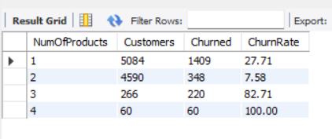
7.SQL Analysis
SQL was used to perform detailed customer retention analysis.
Key Queries Performed
Overall Churn Rate
3.Active vs Inactive customer Analysis
2.Churn by Product Count

Slide 9
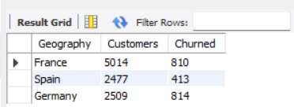
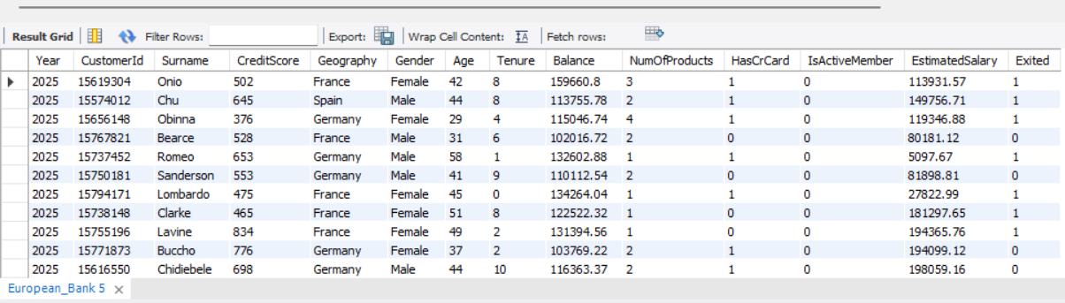
4.Geography-wise Churn Analysis
5. High Balance Inactive Customer Identification

Slide 10
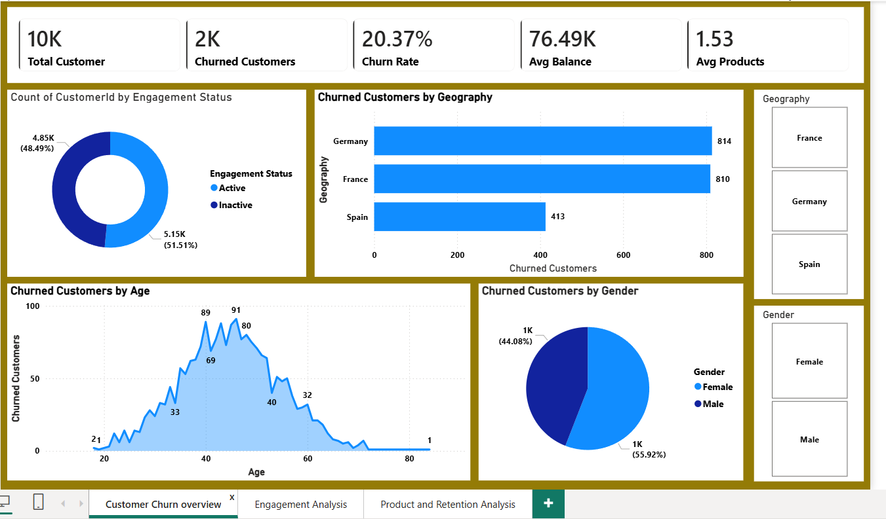
8.Dashboard
(A) Customer Churn Overview

Slide 11
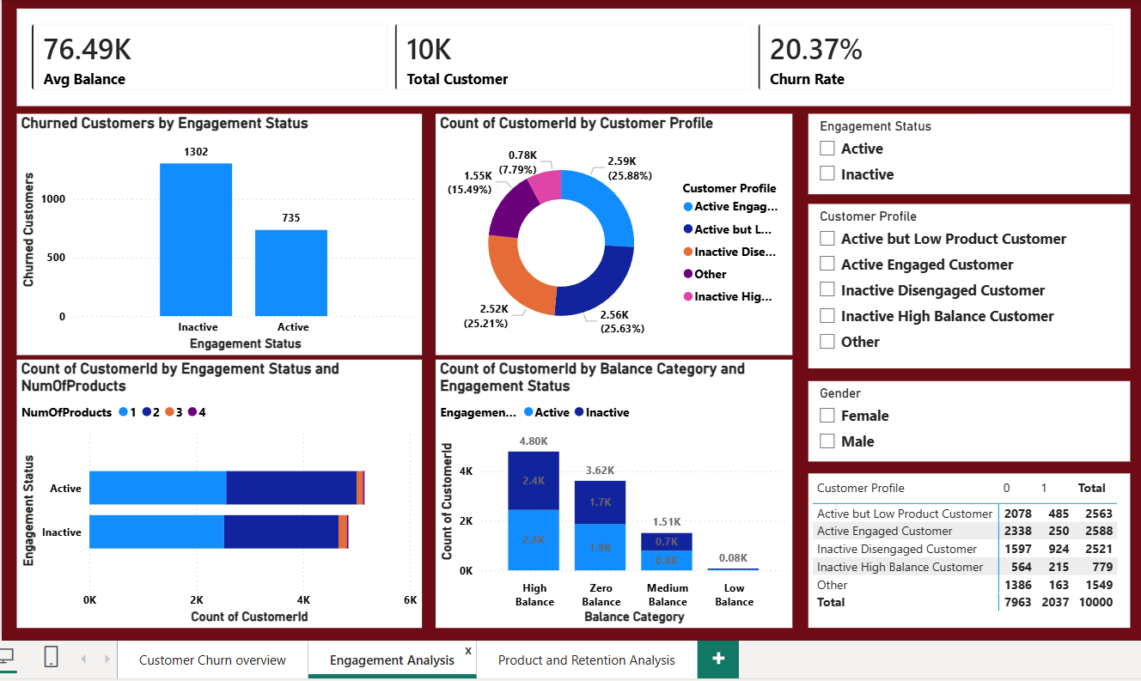
(B) Customer Engagement Analysis

Slide 12
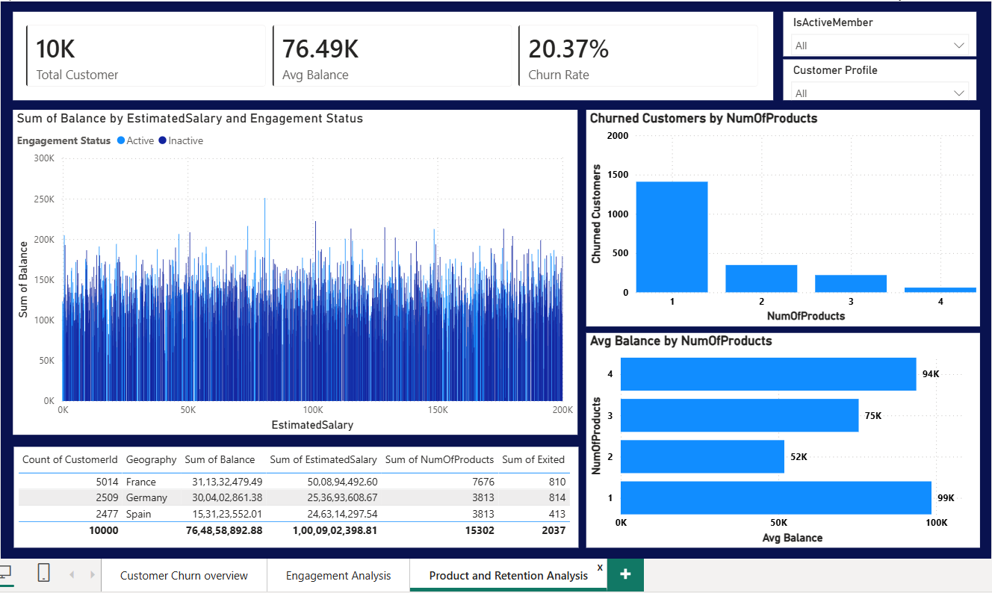
3.Product Utilization & Retention Analysis

Slide 13
9. Key Findings
1.
20.37% overall churn — 1 in 5 customers lost
2.
Inactive customers: 1,302 churned vs. 735 active
3.
Single-product customers: highest churn (~1,400)
4.
Germany & France lead churn; Spain lowest
5.
Females 56% of churn whereas Males 44% of churn

Slide 14
10. Recommendations
1.Increase customer engagement programmes by developing personalised communication campaigns targeting inactive customers.
2. Encourage the single-product-customers to adopt additional products.
3. Since Germany and France contribute the high churn volumes, region- specific retention strategies should be introduced. To identify market-specific issues through customer feedback analysis should be conducted.
4. More focus on high value with high account balance customers by implementing retention programs and by offering personalised financial consultations and loyalty incentives to prevent churn.
5. Improve customer experience by enhancing digital banking services , complaint resolution process and customer support responsiveness.

Slide 15
10. Conclusion
Engagement & product ownership are the key churn drivers
1
Inactive & single-product customers at highest risk
2
779 inactive high-balance customers need immediate action
3

